Slide 1

Thesis Defense
Topic: Metaheuristics For Solving One-Day-Late Delivery System Problems: A Comparative Study And Performance
Date: March 2024
Advisor:
Student:
Dr. Nguyễn Hằng Giang Anh
Phạm Ngọc Huy

Slide 2
Content
01
Problem statement
05
Metaheuristics
02
Literature review
06
Result analysis
03
Methodology
07
Conclusion
04
Mathematical model

Slide 3


Background
Optimizing Online Grocery Logistics
Rising Challenges
Increased logistical costs due to online platforms.
Demand for rapid order picking and delivery.
Facing daily problems is the situation of orders being delivered back, or delivery orders being continuously unsuccessful
Customers expect delivery within a fixed time frame
=> Solution come up: Solve the VRP problem that adjust the policy of original VRP infeasible solution (Allows customers to choose a delivery time frame and can have it delivered again within the given time frame the next day)
Problem statement
Literature review
Methodology
Mathematical model
Metaheuristics
Result analysis
Conclusion

Slide 4
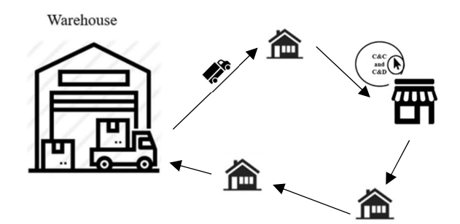
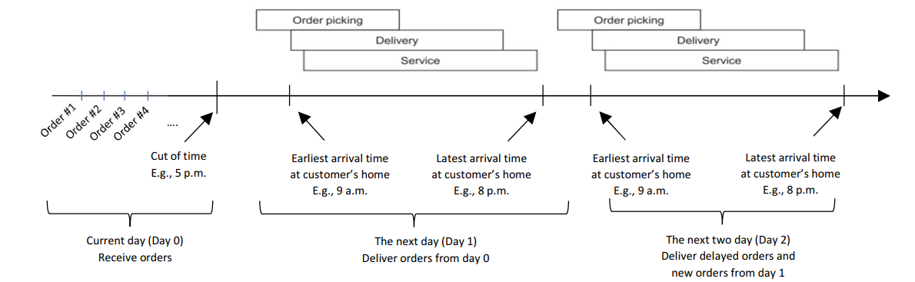
Problem statement
Problem related to delivery:
Design
Routing
Consider resourced used
Time window of customer
Capacity boundary of vehicle
Delay orders occurrence
This study focuses on the routing decision:
How to route to vehicles to:
Serve all the customers in their time constraints
Not violate boundary of vehicle weight
Minimizing total travel distance
Allow to delay the order for tomorrow
Must deliver all the yesterday’s delay orders
Problem statement
Literature review
Methodology
Mathematical model
Metaheuristics
Result analysis
Conclusion

Slide 5
Vehicle routing problem with capacity and time window
Problem | Description | Solution/Method
Time-Dependent Vehicle Routing Problem with Time Windows | The problem is optimizing delivery routes in urban areas with varying travel times due to congestion, known as the Duration-Minimizing Time-Dependent Vehicle Routing Problem with Time Windows (DM-TDVRPTW). Departure times impact route duration significantly. The paper proposes an arc-based model and an efficient hybrid algorithm (ALNS-TS) that explores both feasible and infeasible solutions. ALNS-TS achieves optimal or improved solutions, even in larger-scale scenarios. | Hybrid Algorithm (Adaptive Large Neighborhood Search with Tabu Search (ALNS-TS))
Time-Dependent Vehicle Routing Problem with Time Windows on a Road Network | The paper tackles the Time-Dependent Vehicle Routing Problem with Time Windows (TDVRPTW) in urban settings, dealing with varying travel times and paths for deliveries. It optimizes routes for time-constrained vehicles using a tabu search heuristic. The approach efficiently evaluates solution feasibility and cost, handling instances with up to 200 nodes and 580 arcs effectively, outperforming benchmarks. | Tabu Search Algorithm
Capacitated Vehicle Routing Problem with Alternative Delivery, Pick-Up, and Time Windows | This problem arises from challenges in postal and courier delivery systems and combines elements from various classical Vehicle Routing Problem variants. The unique aspect of CVRP-ADPTW includes the integration of alternative delivery points and parcel lockers into the distribution network, along with consideration for logical constraints. The problem is formulated as Binary Integer Programming (BIP), making it a complex optimization challenge. | Modified Hybrid Approach (Constraint Programming (CP), Genetic Algorithm (GA), and Mathematical Programming)
Problem statement
Literature review
Methodology
Mathematical model
Metaheuristics
Result analysis
Conclusion

Slide 6
Method selection
 | Advantages | Disadvantages
Tabu Search | Efficiently explores complex solution spaces. Allows escaping local optimal using memory structures. Adaptable and tailored to specific problem constraints | Require fine – tuning of parameters. These might be suboptimal solutions in certain cases. Sensitivity to parameter settings
Genetic Algorithm (GA) | Handles large solution spaces effectively. Provides global optimization through population diversity. Suitable for VRP variations with diverse constraints | Slow convergence due to genetic operations. Initial population setup is crucial for finding optimal solutions.
Particle Swarm Optimization (PSO) | Fast convergence, especially in large solution spaces Simplicity in implementation and fewer parameters to tune. Suitable for dynamic VRP scenarios | Prone to premature convergence. Sensitive to parameter settings. Limited ability to escape local optimal.
Simulated Annealing (SA) | Robust in escaping local optimal, allowing exploration of diverse solutions. Can handle VRP variants with complex constraints. Provides global optimization under proper cooling schedules. | Requires careful adjustment of the cooling schedule. Slow convergence, especially in large solution spaces. Might get stuck in local minimal.
=> Based on this analysis, we have chosen to combine genetic algorithms with tabu search to form a metaheuristic approach. This integrated strategy leverages the strengths of each method to mitigate their respective limitations.
Problem statement
Literature review
Methodology
Mathematical model
Metaheuristics
Result analysis
Conclusion

Slide 7
Procedure
Phase 01
Phase 02
Phase 03
MILP Model
Heuristics
Metaheuristics
→ Validate logic of problem
→ Solve small size problems
→ Serve as a benchmark to compare performance of other solution approaches
→ Quickly find feasible initial solutions that are compatible with metaheuristics
→ Reduce computational time
→ Solve larger size problems
Three data sets are involved:
Small size: 5 orders, 3 delayed order, 2 trucks available
Medium size: 15 orders, 4 delayed order, 12 trucks available
Large size: 20 – 70 orders, 40% delayed order, 12 trucks available
Only small size and medium size data set are used to test the MILP model in CPLEX.
Problem statement
Literature review
Methodology
Mathematical model
Metaheuristics
Result analysis
Conclusion

Slide 8
Assumption
Delivery companies, subcontractors, or the retailer's own teams provide resources on demand, with costs based on use. The retailer controls the planning, quickly determining the needed resources to meet customer orders within the set timeframe.
A sufficient number of vehicles are accessible at the start of the planning horizon.
All items assigned to the customer orders must be prepared and loaded onto the vehicle by the warehouse.
Customers can order by a specific time (e.g., 5 p.m.) to have their orders included in the next day's delivery schedule. Vehicles are booked in advance to secure availability. The picking process begins at 6 a.m., and deliveries are completed by 8 p.m. at the customer's location.
Problem statement
Literature review
Methodology
Mathematical model
Metaheuristics
Result analysis
Conclusion

Slide 9
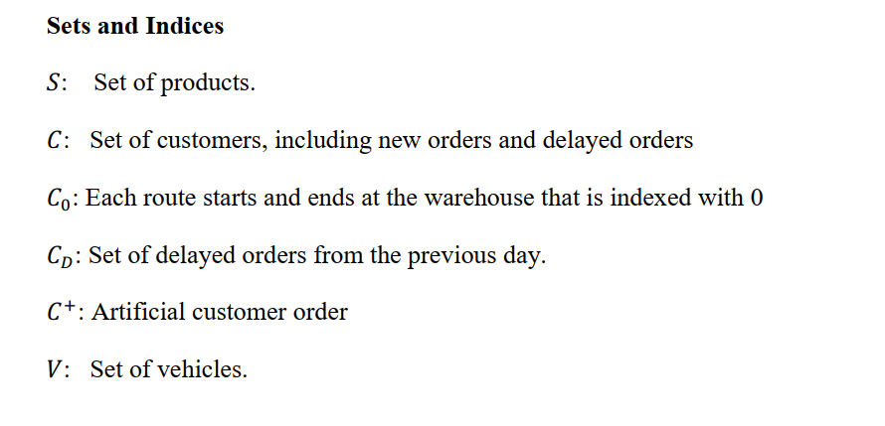
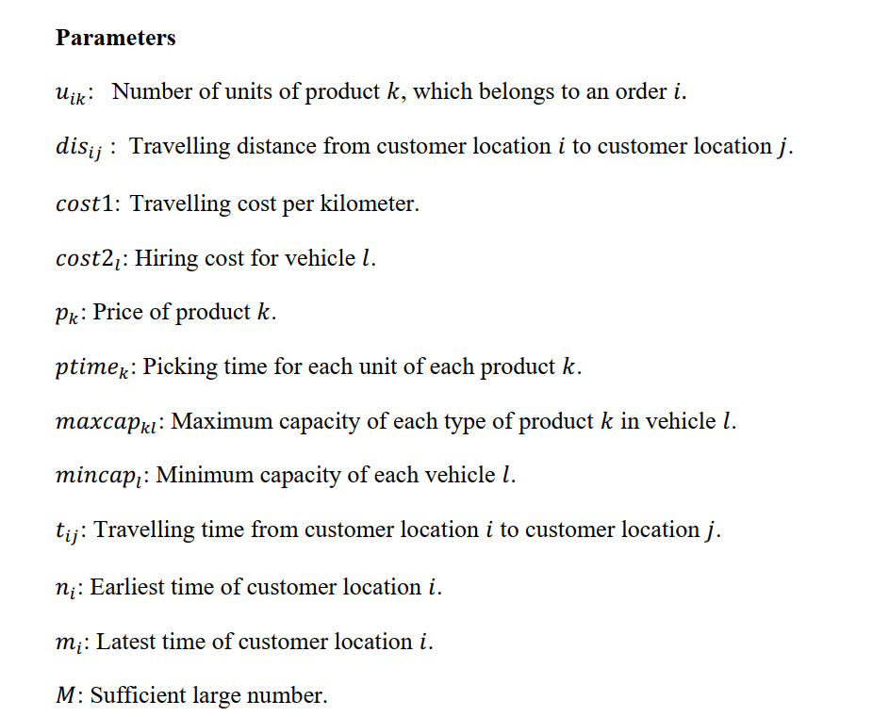
Sets & parameters
Problem statement
Literature review
Methodology
Mathematical model
Metaheuristics
Result analysis
Conclusion

Slide 10
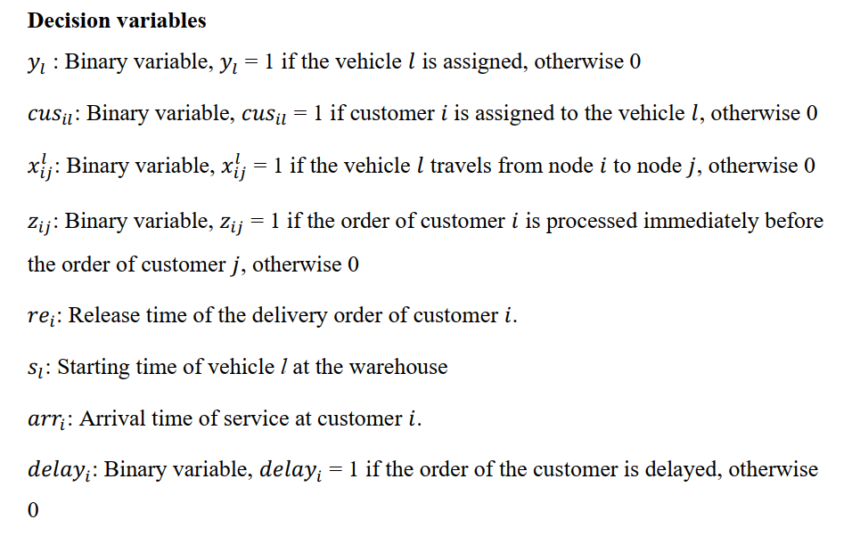
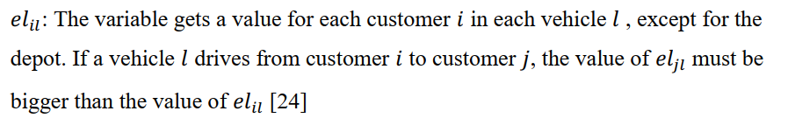
Decision variables
Problem statement
Literature review
Methodology
Mathematical model
Metaheuristics
Result analysis
Conclusion

Slide 11
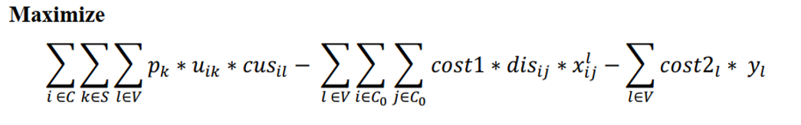
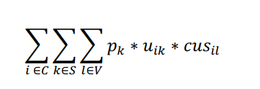

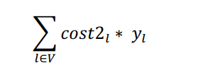
Objective function
The objective is to maximize the profit of the company
(1)
Where
 | The total revenue function outlines the earnings generated from the delivery of all fulfilled orders.
 | The traveling expenses are linked to all generated tours
 | The costs related to employing vehicles are contingent upon the number of vehicles utilized. It is important to note that the cost per kilometer traveled remains consistent, while the employment cost varies for each individual vehicle
Problem statement
Literature review
Methodology
Mathematical model
Metaheuristics
Result analysis
Conclusion

Slide 12
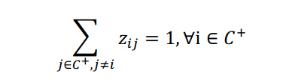
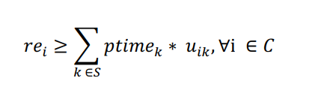
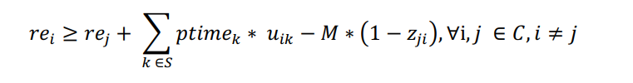
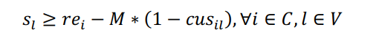
Order-picking subproblem constraints
 |  | Specify the time a delivery order is released
 |  | The order picking and vehicle routing subproblems are connected. A tour cannot start until all the corresponding orders have been supplied by the warehouse
(2)
(3)
(4)
(5)
Problem statement
Literature review
Methodology
Mathematical model
Metaheuristics
Result analysis
Conclusion

Slide 13
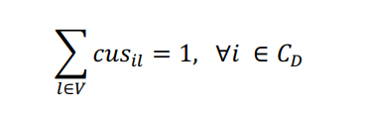
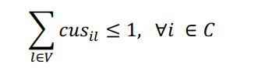
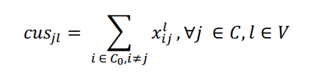
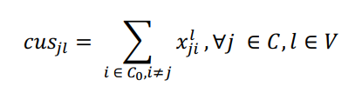
Constraints
 |  | The delayed orders from the previous day must be delivered in the next day
 |  | A customer is assigned to exactly one vehicle if all requirements, which are time window and capacity, are satisfied
 |  | The integrity of routing and customer-vehicle assignment. They also guarantee that the depot is included in a route containing at least one customer
(6)
(7)
(8)
(9)
Problem statement
Literature review
Methodology
Mathematical model
Metaheuristics
Result analysis
Conclusion

Slide 14
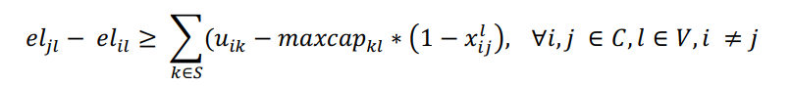
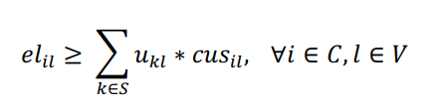
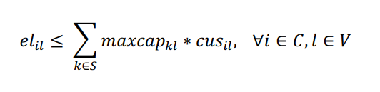
Subroute elimination constraints
 |  | Prevent the formation of subroute issues by MTZ (Miller Tucker Zemlin)
(10)
(11)
(12)
Problem statement
Literature review
Methodology
Mathematical model
Metaheuristics
Result analysis
Conclusion

Slide 15
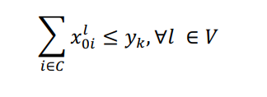
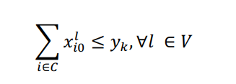
Routing Constraints
 |  | Each vehicle is limited to undertaking a single tour, and it must start from the depot and end at the depot
(13)
(14)
Problem statement
Literature review
Methodology
Mathematical model
Metaheuristics
Result analysis
Conclusion

Slide 16
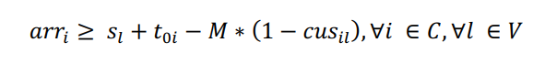
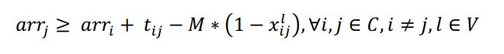
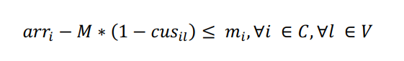
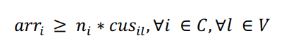
Time – window constraints
 |  | Define the earliest possible starting time of a service at customer’s home, which cannot be earlier than when the vehicle arrives at that location or earlier than the lower bound of the delivery time window defined
(15)
(16)
(17)
(18)
Problem statement
Literature review
Methodology
Mathematical model
Metaheuristics
Result analysis
Conclusion

Slide 17
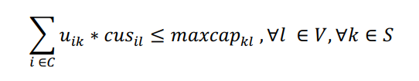
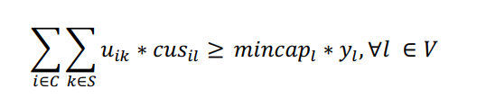
Capacity limit constraints
 |  | The maximum capacity limits of each boxes of the vehicles
 |  | If the total number of boxes cannot meet the minimum capacity, these orders will not be processed by vehicle.
(19)
(20)
Problem statement
Literature review
Methodology
Mathematical model
Metaheuristics
Result analysis
Conclusion

Slide 18
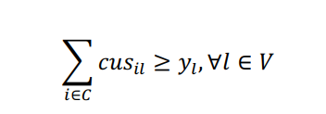
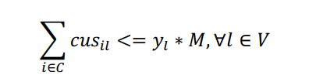
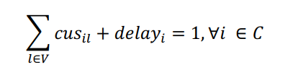
Vehicle and Delay Constraints
 |  | Determine whether the vehicle is used or not
 |  | Records which orders will be delayed in the current schedule and must be delivered in the next days
(21)
(22)
(23)
Problem statement
Literature review
Methodology
Mathematical model
Metaheuristics
Result analysis
Conclusion

Slide 19
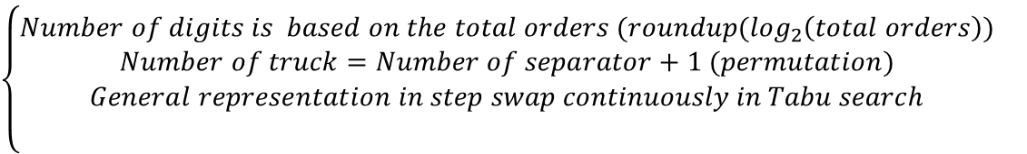

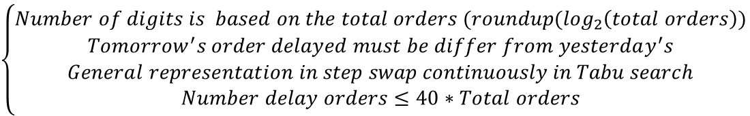
Solution presentation
The solution presentation contains three parts (Route array – Separator array – Delay array)
Where:
Route array
2 | 1 | 3 | 5 | 4 | 6 | 7 | 9 | 8 | 10
$$\left\{\begin{aligned}Permutation oftotal number of orders \\ Must include all the yesterday^{′}s orders delayed \\ \end{aligned}\right.$$
$$\left\{\begin{aligned}Number of digits is based on the total orders (roundup(\log_{2}\left(total orders\right)) \\ Number of truck=Number of separator+1 (permutation) \\ General representation in step swap continuously in Tabu search \\ \end{aligned}\right.$$
Separator array
[1 0 0 1] | [1 1 1 1] | [1 1 0 1] | [1 1 1 0] | [0 0 0 1]
$$\left\{\begin{aligned}Number of digits is based on the total orders (roundup(\log_{2}\left(total orders\right)) \\ Tomorrow^{′}s order delayed must be differ from yesterday^{′}s \\ General representation in step swap continuously in Tabu search \\ Number delay orders≤40∗Total orders\end{aligned}\right.$$
Delay array
[1 1 1 1] | [1 1 0 1] | [1 1 1 0] | [1 1 1 1]
Problem statement
Literature review
Methodology
Mathematical model
Metaheuristics
Result analysis
Conclusion

Slide 20
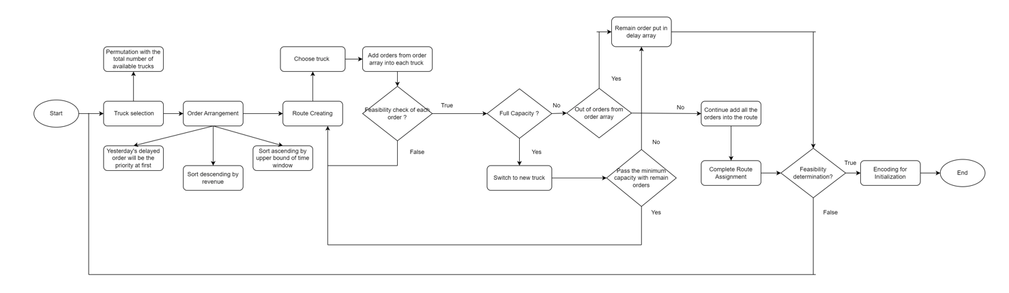
Heuristics for Initialization
Problem statement
Literature review
Methodology
Mathematical model
Metaheuristics
Result analysis
Conclusion

Slide 21
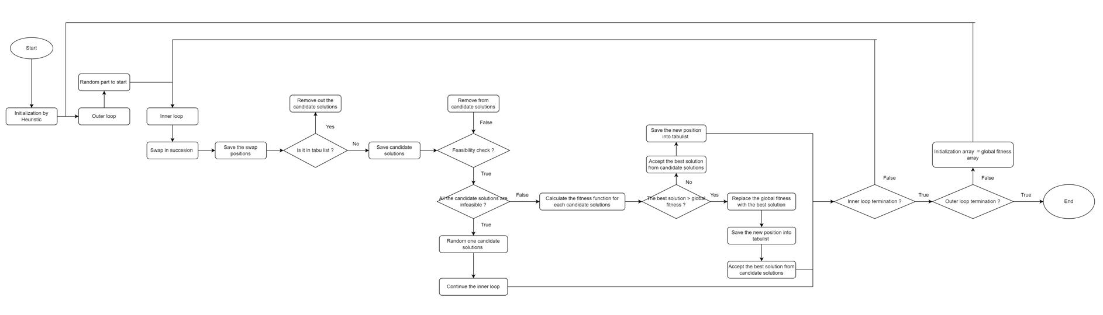
Tabu Search
Problem statement
Literature review
Methodology
Mathematical model
Metaheuristics
Result analysis
Conclusion

Slide 22
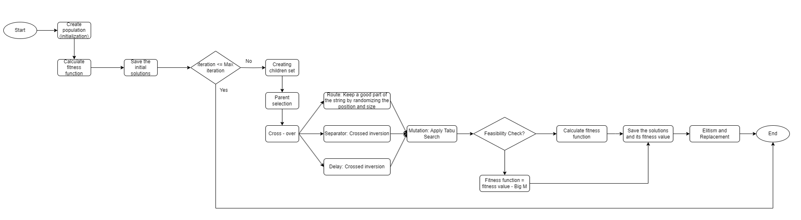
Genetics Algorithm – Tabu Search Hybrid
Problem statement
Literature review
Methodology
Mathematical model
Metaheuristics
Result analysis
Conclusion

Slide 23
Data collection
Transition from multichannel retail to centralized warehouse for online orders
Analysis based on customer interactions, warehouse operations, logistics data
Average of 109 online orders processed daily
Structured dispatch schedule with specific picking times:
2 minutes for dry and fresh products
2.5 minutes for frozen goods
Partnership with third-party for a 12 multi-compartment truck fleet:
Accommodates dry, fresh, and frozen products
Shift from owning two vehicles to outsourcing
Costs:
$0.9 per kilometer transportation fee
Variable vehicle usage charge based on features
Use of pin technology on google maps for precise delivery locations
Time calculation will perform in minutes (collect in hours):
Time window change
Slots | Model (hours) | Real (hours)
1 | 2 -> 4 | 8 -> 10
2 | 4 -> 6 | 10 -> 12
3 | 6 -> 8 | 12 -> 14
4 | 8 -> 10 | 14 -> 16
5 | 10 - > 12 | 16 -> 18
6 | 12 -> 14 | 18 -> 20
Prioritizing delayed orders based on their receipt dates. As illustrated, delayed orders (1, 2, 3) are addressed before processing new ones (4, 5, 6, 7).
Order | Product 1 | Product 2 | Product 3
1 | 4 | 2 | 1
2 | 1 | 2 | 2
3 | 1 | 2 | 3
4 | 1 | 2 | 1
5 | 3 | 1 | 2
6 | 1 | 1 | 1
7 | 1 | 2 | 3
Problem statement
Literature review
Methodology
Mathematical model
Metaheuristics
Result analysis
Conclusion

Slide 24
Performance of MILP model in CPLEX SOLVER
Policy adjustment (Test with small size instance):
Instance 1: 10 total orders 4 delayed orders 6 vehicles | The objective value is $1032.27 Total cost is $204.725 Delay orders: None
Instance 2: 10 total orders 4 delayed orders 1 vehicle | The objective value is $627.482 Total cost is $122. 518 Delay orders: [5, 6, 7, 10]
Conclusion: In the revised problem, if delivery to any customer is not possible on the requested day, the order can be rescheduled for the next day, with a limit of one redelivery attempt. This change makes previously infeasible delivery schedules feasible.
Problem statement
Literature review
Methodology
Mathematical model
Metaheuristics
Result analysis
Conclusion

Slide 25
Performance of MILP model in CPLEX SOLVER
Test with medium size instance (15 orders, 4 delayed order, 12 trucks available):
Objective value (Profit): $1,701.255
 | Release time of the delivery order (minutes) | Starting time of truck at warehouse (minutes) | Arrival time (minutes) | Delayed today
1 | 14.5 | - | 480 | 0
2 | 11 | - | 240 | 0
3 | 13.5 | - | 600 | 0
4 | 8.5 | - | 730.5 | 0
5 | 13 | 21.5 | 840 | 0
6 | 6.5 | - | 642.29 | 0
7 | 13.5 | 21.5 | 240 | 0
8 | 14.5 | - | 240 | 0
9 | 15 | - | 720 | 0
10 | 10.5 | - | 240 | 0
11 | 21.5 | - | 305.1 | 0
12 | 9 | - | 600 | 0
13 | 12.5 | - | 600 | 0
14 | 15 | - | 120 | 0
15 | 10.5 | - | 455.25 | 0
Route 1:
 | Order
Truck 5 | Depot | 15 | 1 | 3 | 13 | 6 | 9 | 4 | 5 | Depot
Route 2:
 | Order
Truck 7 | Depot | 14 | 8 | 2 | 10 | 7 | 11 | 12 | Depot
Conclusion: Medium size is the maximum size that mathematical model can solve. We will need to apply metaheuristic to upscale the model
Problem statement
Literature review
Methodology
Mathematical model
Metaheuristics
Result analysis
Conclusion

Slide 26
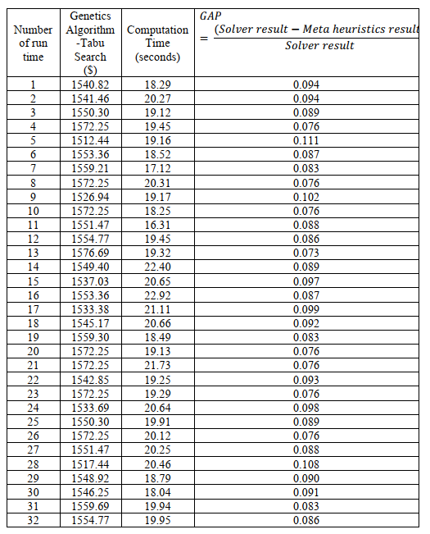
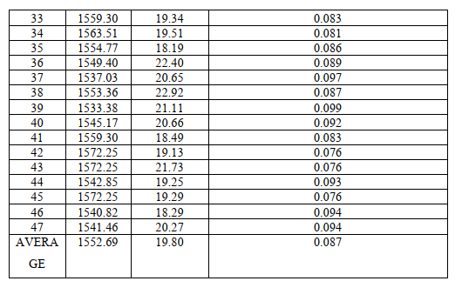
Comparison between MILP and Genetics Algorithm – Tabu Search
Comparison with medium size: 15 orders, 4 delayed order, 12 trucks available
MILP solution: 1701.255 and Time solve: 44s
=> The hybrid approach achieved 91% of the mathematical model's efficiency but required less than half the time, at just 19.80 seconds, indicating an 9% performance gap.
Problem statement
Literature review
Methodology
Mathematical model
Metaheuristics
Result analysis
Conclusion

Slide 27
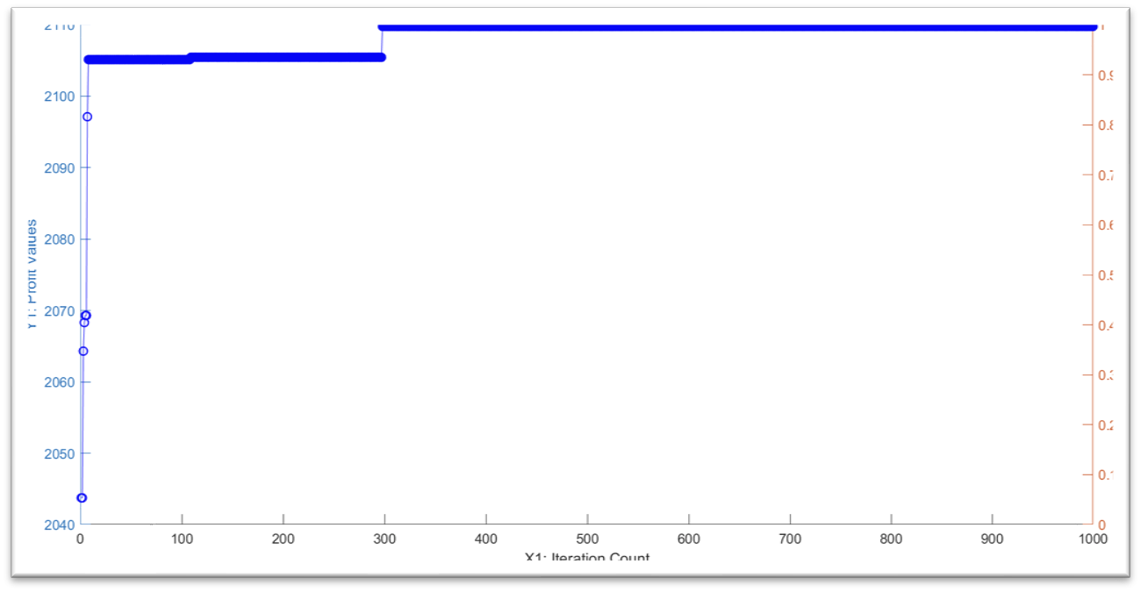
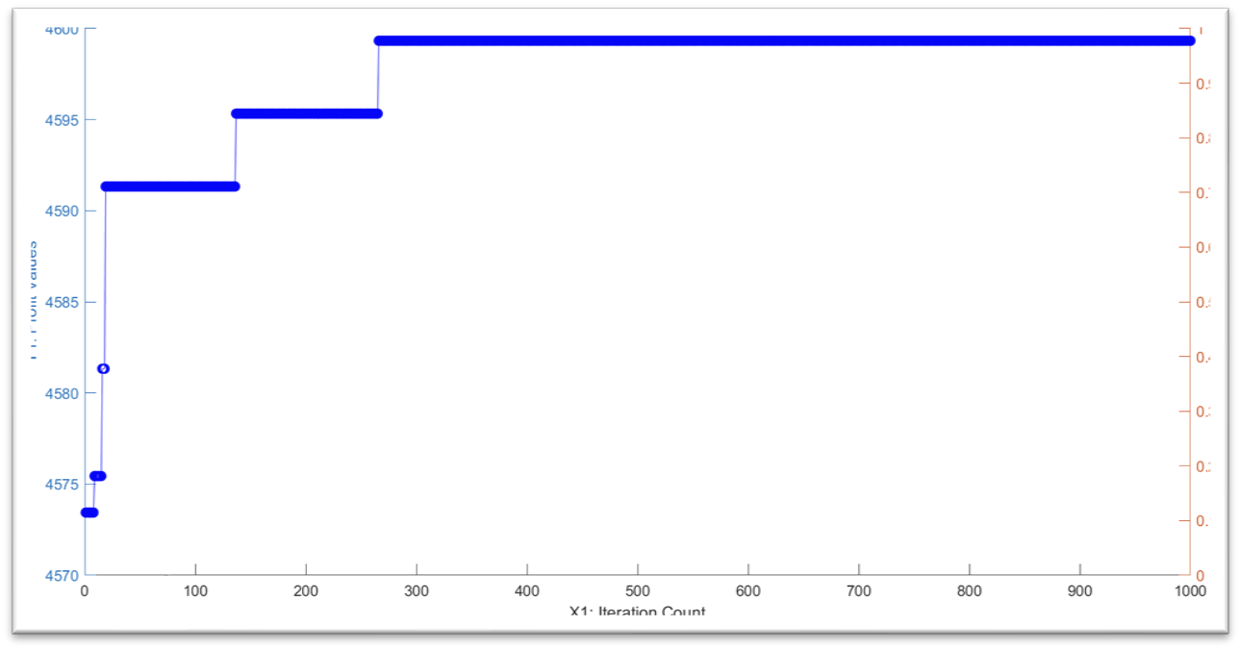
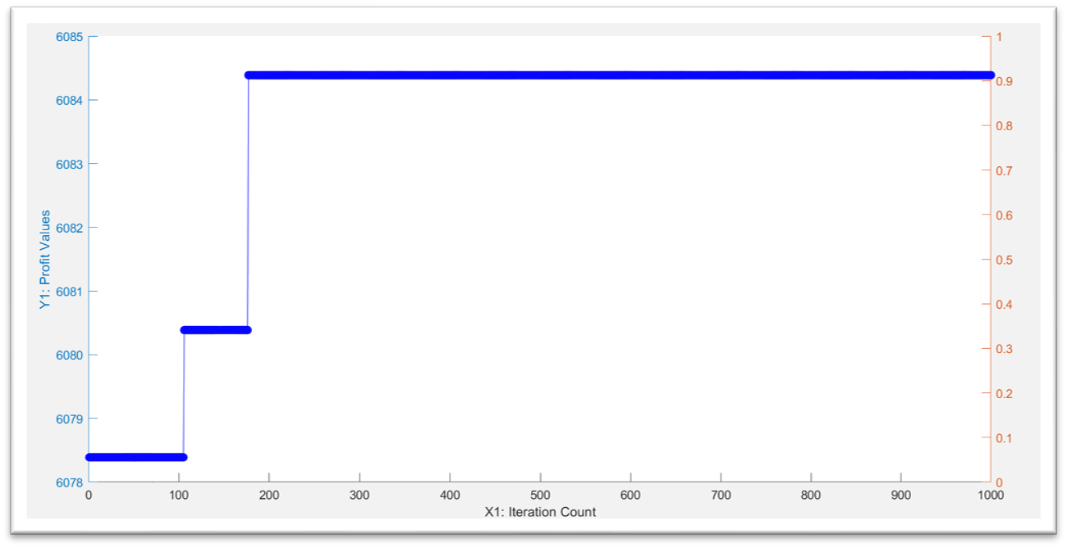
Scalability of Tabu Search
Instance 1: 20 total orders 8 delayed orders 12 vehicles |  | The objective value is $2109.75900000000 Time lapse: 279.840664 seconds Delay orders: None.
Instance 2: 50 total orders 20 delayed orders 12 vehicles |  | The objective value is $4599.32714500000 Time lapse: 784.033145 seconds. Delay orders: [30, 45, 44, 42]
Instance 3: 70 total orders 28 delayed orders 12 vehicles |  | The objective value is $6084.400 Time lapse: 641.467903 seconds Delay orders: [62, 65, 67, 70]
Problem statement
Literature review
Methodology
Mathematical model
Metaheuristics
Result analysis
Conclusion

Slide 28
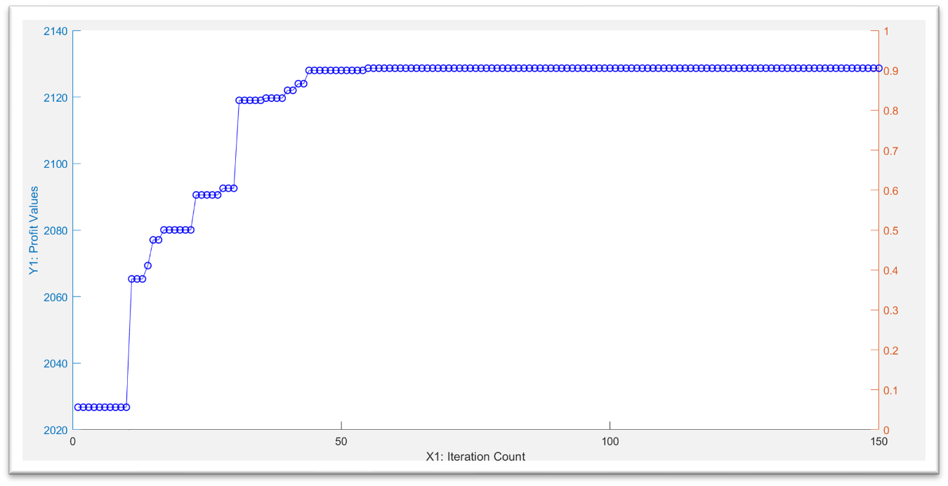
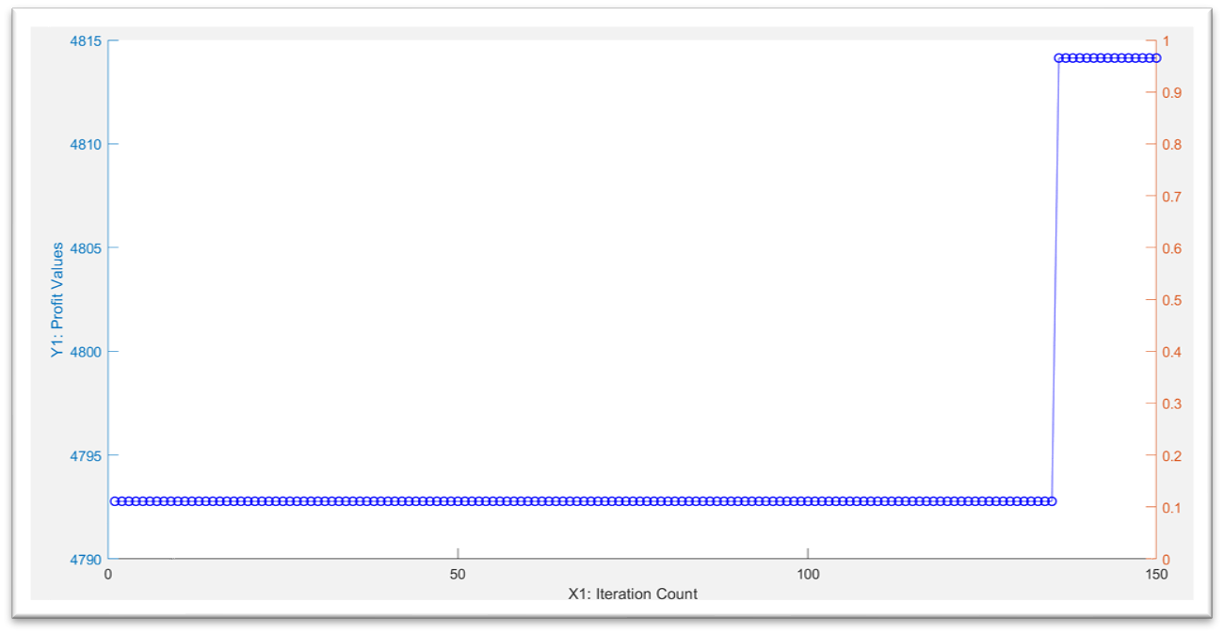
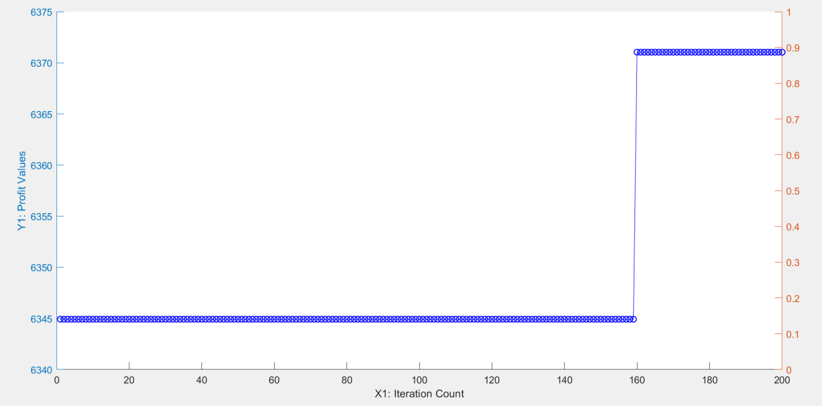
Scalability of Genetics Algorithm – Tabu Search
Instance 1: 20 total orders 8 delayed orders 12 vehicles |  | The objective value is $2128,7000 Time lapse: 452.073255 seconds Delay orders: None.
Instance 2: 50 total orders 20 delayed orders 12 vehicles |  | The objective value is $4814.100 Time lapse: 1084.380179 seconds Delay orders: None.
Instance 3: 70 total orders 28 delayed orders 12 vehicles |  | The objective value is $6371.000 Time lapse: 1550.83 seconds Delay orders: [63, 64]
Problem statement
Literature review
Methodology
Mathematical model
Metaheuristics
Result analysis
Conclusion

Slide 29
Conclusion
Holistic Approach
Integrating order picking and transportation.
Enhancing the full spectrum from product preparation to delivery.
Cost and Efficiency
Optimizing costs and scheduling.
Efficient routing of delivery trucks.
Flexible Delivery Options
Introducing delivery delays for increased efficiency.
Tailored solutions for varied delivery locations.
Realistic Constraints Adherence
No compromise on real-world constraints.
Practical framework reflecting true logistical complexities.
Applying and testing real datas.
Problem statement
Literature review
Methodology
Mathematical model
Metaheuristics
Result analysis
Conclusion

Slide 30
References
Islam, M. A., Gajpal, Y., & ElMekkawy, T. Y. (2021). Hybrid particle swarm optimization algorithm for solving the clustered vehicle routing problem. Applied Soft Computing, 110. https://doi.org/10.1016/j.asoc.2021.107655
Hannan, M. A., Akhtar, M., Begum, R. A., Basri, H., Hussain, A., & Scavino, E. (2018). Capacitated vehicle-routing problem model for scheduled solid waste collection and route optimization using PSO algorithm. Waste Management, 71. https://doi.org/10.1016/j.wasman.2017.10.019
Pan, B., Zhang, Z., & Lim, A. (2021). A hybrid algorithm for time-dependent vehicle routing problem with time windows. Computers and Operations Research, 128. https://doi.org/10.1016/j.cor.2020.105193
Li, H., Wang, H., Chen, J., & Bai, M. (2020). Two-echelon vehicle routing problem with time windows and mobile satellites. Transportation Research Part B: Methodological, 138. https://doi.org/10.1016/j.trb.2020.05.010
Sitek, P., Wikarek, J., Rutczyńska-Wdowiak, K., Bocewicz, G., & Banaszak, Z. (2021). Optimization of capacitated vehicle routing problem with alternative delivery, pick-up and time windows: A modified hybrid approach. Neurocomputing, 423. https://doi.org/10.1016/j.neucom.2020.02.126

